Slide 1

Notes:
SLIDE 1

Slide 2
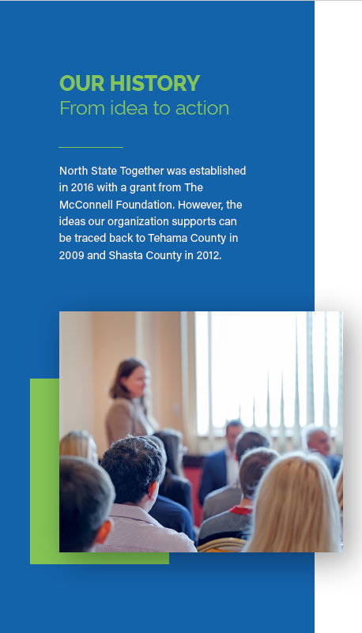
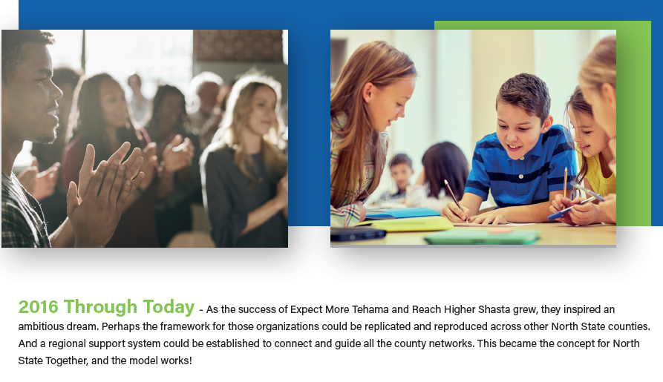

Notes:
SLIDE 2:

Slide 3
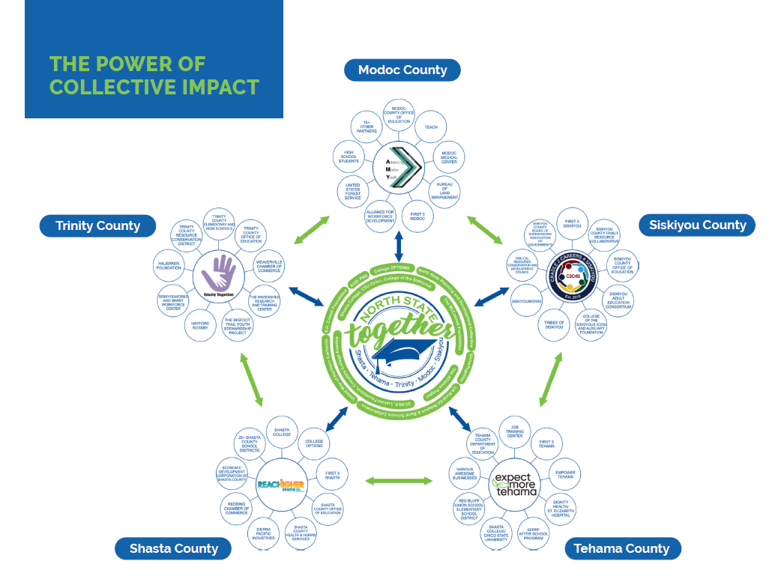
Notes:
SLIDE 5:

Slide 4
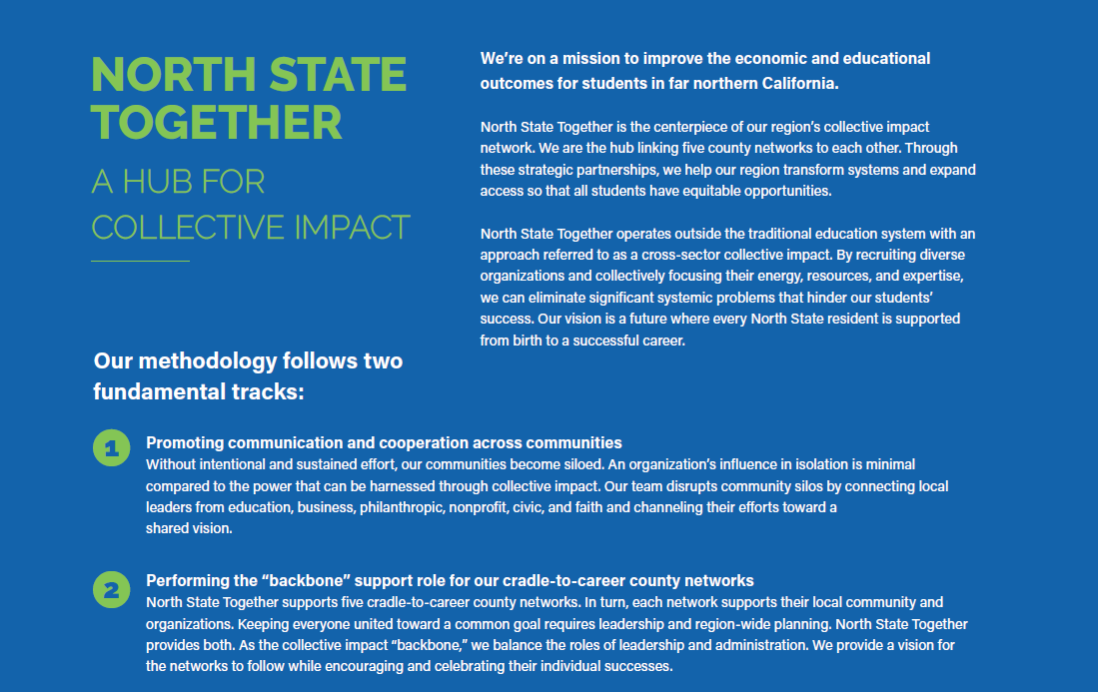

Slide 5
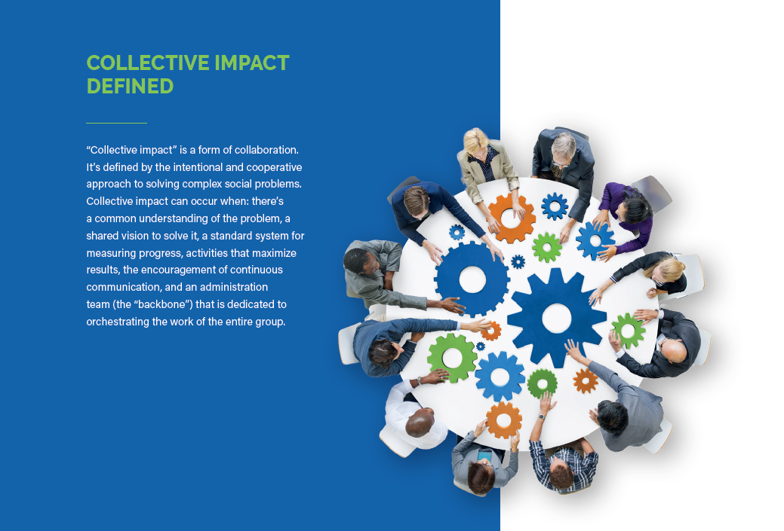


Slide 6
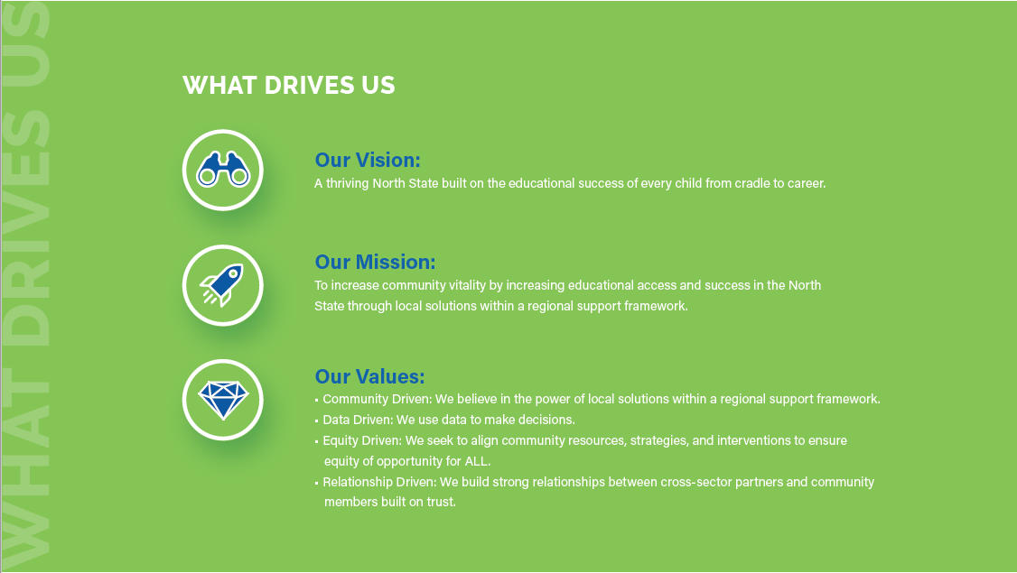
Notes:
SLIDE 3: I’m used to presenting to folks that are not familiar with cradle to career collerive impact model so I won’t delve into the basics of what you already know because you are already doing the work.
But What makes us different than other cradle to career collaboratives is our regional support framework that allows for the autonomy necessary in the communities we serve to identify their own unique problems as well as implement their local solutions, but all within our support framework and regional vision, mission, values and now assessing collective impact teams individually as well as our region as whole using the Theory of Action framework as the new StriveTogether network members.
We are also different in that we are housed under the Shasta Tehama Trinity Joint Community College District allowing us to use their infrastructure in Kind which has lent itself to our success as there was built in credibility and relationships just rom the reputation the college has in our communities.
Our Vision: A thriving North State built on the educational success of every child from cradle to career.
Our Mission: To increase community vitality by increasing educational access and success in the North State through local solutions within a regional support framework.
Our Values: We are driven by our core values:
Community Driven: We believe in the power of local solutions within a regional support framework.
Data Driven: We use data to make decisions.
Equity Driven: We seek to align community resources, strategies, and interventions to ensure equity of opportunity for ALL.
Relationship Driven: We build strong relationships between cross-sector partners and community members built on trust.

Slide 7
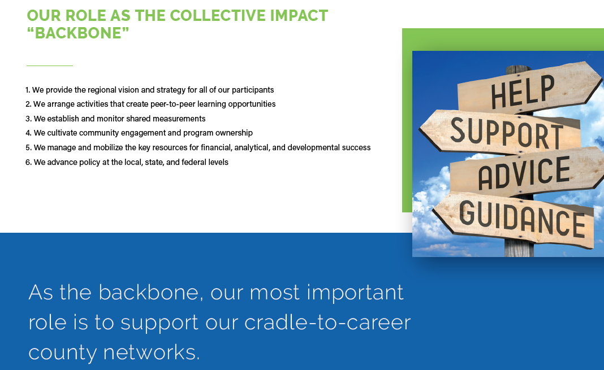

Slide 8
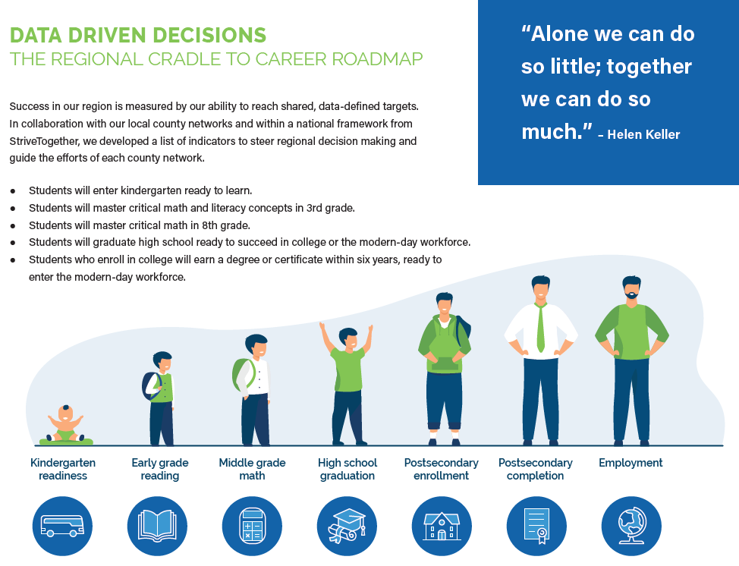
Notes:
SLIDE 7:
North State Together addresses our unique region’s challenges and elevate opportunities for cradle to career success.
Less than 50% of our Kindergarteners are ready for school
Only 34% of our 8th graders are at grade level in Math
31% of the adults in our region have some college but no degree
Historically, we have a really high school graduation rates.

Slide 9
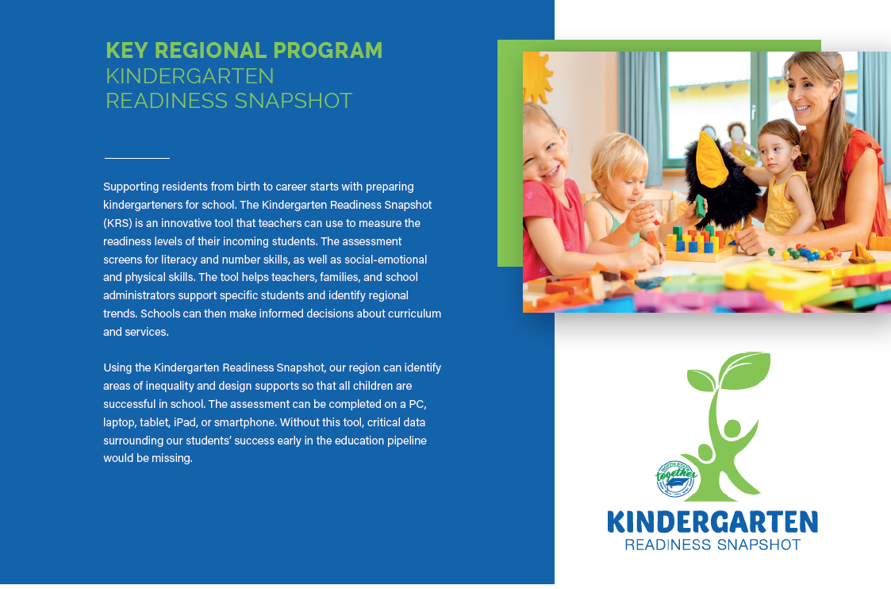

Notes:
SLIDE 8
While backbone collective impact organization such as North State Together do not normally oversee direct programs, we made the exception for two areas we deemed really important for our region one of which is the Kindergarten Readiness Snapshot tool which assesses kindergarteners readiness for school. We did this because A missing data component along the educational pipeline has been kindergarten readiness, and how could we createa cradle to career data pipeline without knowing how our students were doing upon entering school from the all important first 5 years.
Kindergarten Readiness
North State Together is committed to improving outcomes in all areas along the cradle to career pipeline. A missing data component along the educational pipeline has been kindergarten readiness. A large body of research has shown that kindergarten readiness is a strong predictor of later academic achievement and school adjustment. Readiness assessments help our region understand how prepared our children are for kindergarten so that they can provide necessary supports to ensure all children are successful in elementary school and beyond.
In 2019, North State Together took over KRS administration and due to the pandemic we worked hard to make the Kindergarten Readiness Snapshot (KRS) system fully mobile compliant for Fall 2020. This means that the KRS system can be used anywhere on any device with a WiFi connection. No more relying on an iOS app that needs to be downloaded to an iOS device and maintained. KRS assessments can now be done on a PC, laptop, tablet, iPad, even your smartphone.
As we might expect, school readiness dropped drastically from Fall 2019 to Fall 2020. In Fall 2019 almost 51% of our children were Kinder ready, and in the Fall 2020 that number had dropped to 33.96%.
Along with the conversion to a mobile compliant platform, the North State Together backbone team has worked to not only make KRS more user friendly, but to make the back-end and reporting more user friendly as well. Registering as a user is now more streamlined and reports are more meaningful. This new platform also gives North State Together the ability to work with its partners and those using the KRS system to expand and enhance the system even further in the future. This means better data, better reporting and better results for the region that North State Together and KRS serves.
Kindergarten Readiness Snapshot is a tool kindergarten teachers may use to assess and store information about incoming kindergarten students’ kindergarten readiness levels. The “Snapshot” screens readiness in literacy, numeracy, and social-emotional/physical skills.
Through its current Kindergarten Readiness Snapshot, teachers and families and school administrators can learn more about the status of their child’s literacy and numeracy development, social and emotional development, and physical development at one key point in time. The Snapshot is an innovative, electronic application-based measure to be administered by teachers early in the school year to capture specific facets of what children entering school know and can do. Findings are intended to be used formatively at the classroom and school levels to support instructional planning and at the district level to better understand any changes that may emerge over time in the developmental readiness of children in the North State at school entry.
Questions included in the Snapshot are based on questions from other validated or commonly used assessments (i.e., Desired Results Developmental Profile (DRDP), California Department of Education Preschool Learning Foundation’s 60 month Goals).
For more information on KRS and to view the kinder ready data for our region, visit http://northstatetogether.org/krs/

Slide 10
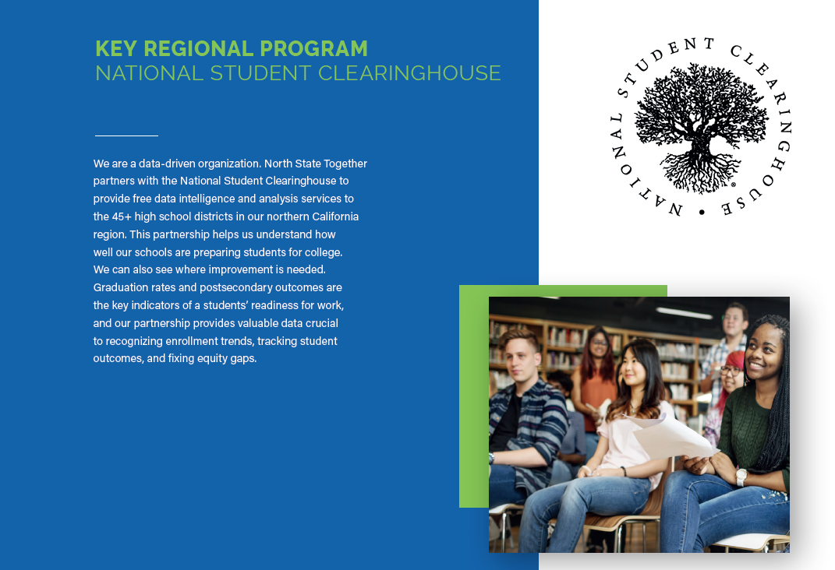

Slide 11
Regional K-16 Grant Overview
The Regional K-16 Education Collaborative Grant Program, requires a collaborative to meet all of the following criteria, by law:
  At least 1 K-12 school district, 1 UC, 1 CSU, and at least one CC.
  Establish a steering committee of which at least 25%+ of the members shall be local employers.
  Commit to participate in the California Cradle-to-Career Data System.
  Commit to implement at least four of the following seven recommendations from the February 2021 Recovery with Equity report to promote student success
  Commit to create occupational pathways, including accelerated degree and/or credential programs that incorporate work-based learning, in at least two of the sectors four eligible sectors
      Healthcare
      Education
      Business Management
      Engineering or Computing

Slide 12
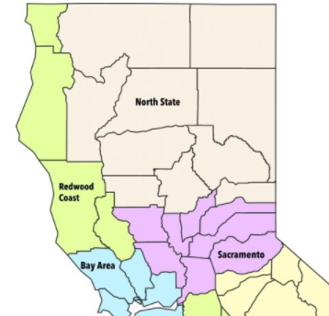
The North State Region
The intent of the grant is to incentivize regional education and workforce collaboration to make a significant impact on the regional economy
Only one grant awarded per region for Phase 1 and Phase 2 combined
(if we get Phase 1, we cannot apply for Phase 2)
Butte
Glenn
Lassen
Modoc
Plumas
Shasta
Sierra
Siskiyou
Tehama
Trinity

Slide 13
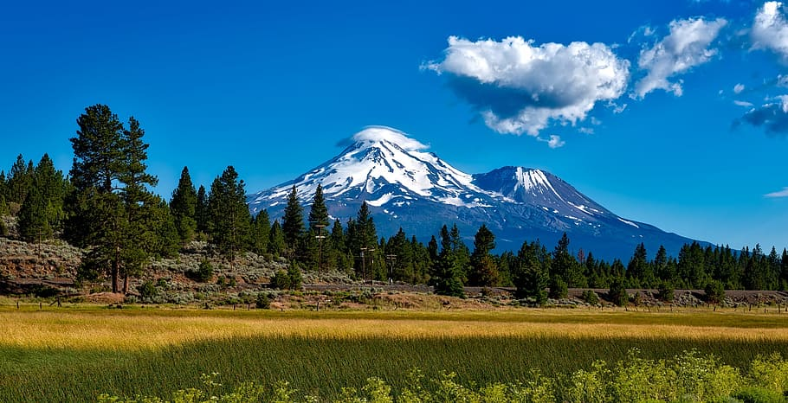
The Future:
North State Together Regional Model Expansion
North State Together K16 Collaborative
A rural approach to student, family, and community success.
Vision
The Remote North State Together K16 Collaborative, a cross-sector group of partners representing education, business, community organizations, and local government, strives to improve the economic and personal lives of community members that live and work in the remote North. Together, we are building inclusive, supportive pathways that are responsive to local needs and retain the talent in our region by sharing resources, centering equitable strategies, promoting sustainability, and building lasting partnerships across sectors and geography.
Pathways
Healthcare
Education
Strategies
Cultivate inclusive, engaging, equity-oriented learning environments
Retain students through inclusive supports
Support college preparation and early credit
Provide high-tech, high-touch advising

Slide 14
New County Network Onboarding
Create a cross-sector team of diverse stakeholders with 25% or more from industry and at least 1 from K-12 district
Structure around major focus areas:
    K-16 Collaborative Grant
    Community Economic Resilience Fund (CERF)
Name your team (i.e., Expect More Tehama, Cradle to Careers for Siskiyou, Reach Higher Shasta, Advancing Modoc Youth, Trinity Together, etc.)
Identify a Fiscal Agent
Identify representative for North State Together Advisory Board
Sign terms and conditions with North State Together (currently being updated to include new funding opportunities):
    Includes nonbinding Data Sharing agreements across educational sectors with North State Together
    Incudes Participating in Cradle to Career Data System including at least one K-12 District in agreeing to participate in CCGI

Slide 15
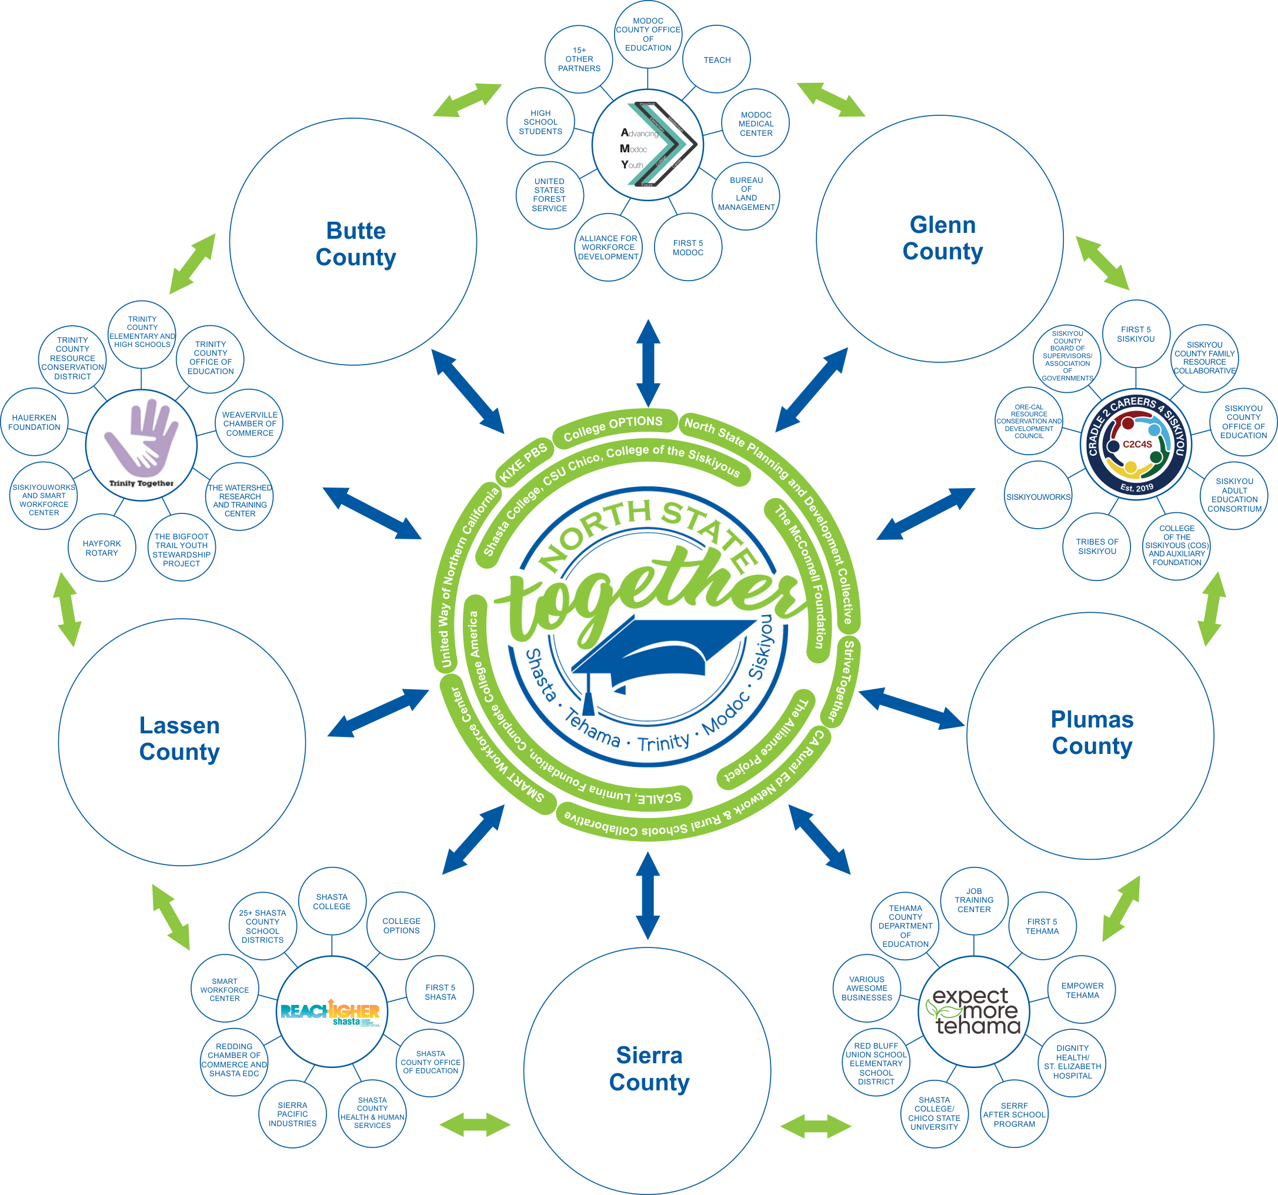
Notes:
SLIDE 5:

Slide 16
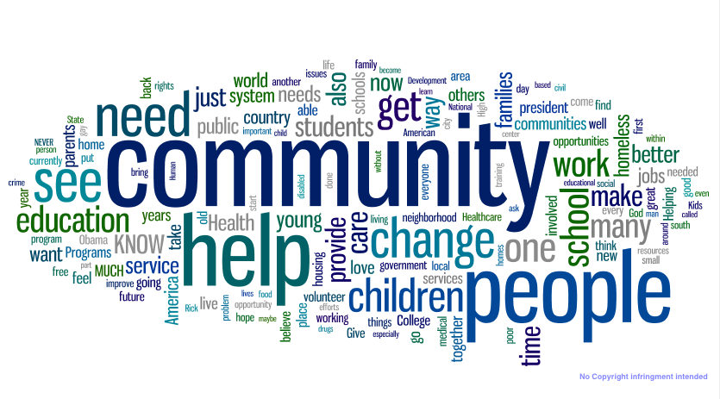

Contact Us
Collectively, we improve outcomes for our region thereby improving the overall health and vitality of our communities.
Thank you! Questions? nst@shastacollege.edu
Our Website:
Northstatetogether.org

